Slide 1
And there came a voice to him:
“Rise, Peter; kill and eat.”
Acts 10:13, English Standard Bible

Slide 2
Life as a “Fowler”

Slide 3
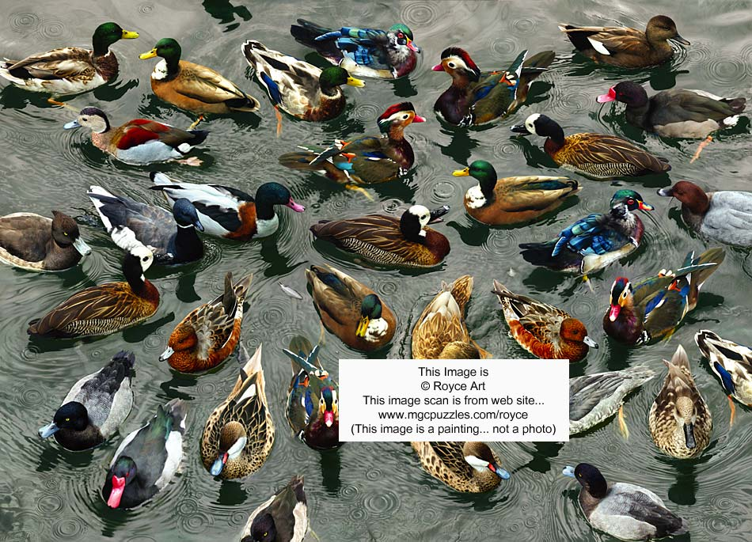
A Background in Waterfowling…
Dad was a hunter
Had me shooting as a boy
A duck call got me hooked on Hunting
“Take your boy hunting and you won’t have to go hunting for your boy…”

Slide 4
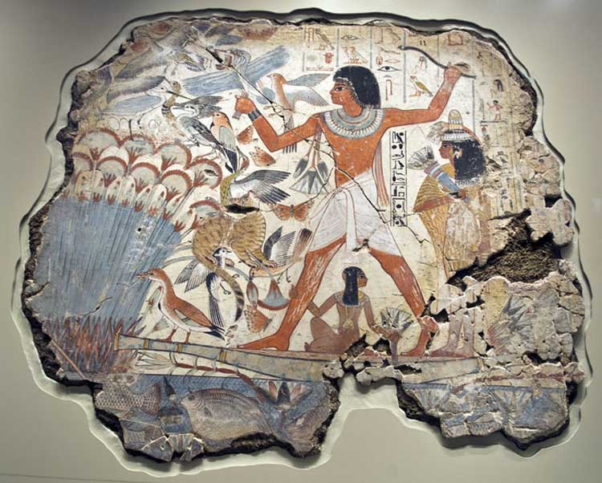
A Duck Dynasty!
The History, Egyptians!
Early Market Gunning in America
Duck Attributes
Amazing Aviators & Navigators
Puddle Ducks, Diving Ducks, Tree Ducks

Slide 6
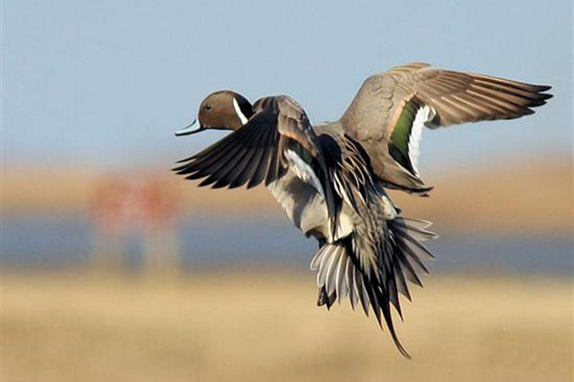
Why I Enjoy Waterfowling
Used to be the hunt
Now the great friendships
I am amazed at God’s incredible Creation!
The Duck, Aviator, Navigator, Worthy Quarry
Calling ducks into close range
The beauty
The “Shot”…

Slide 7
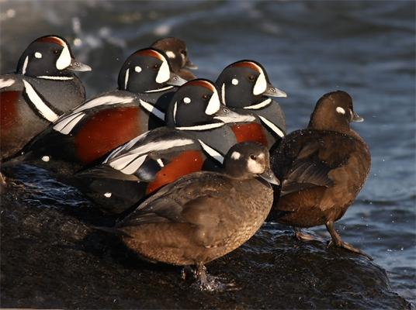
Different Types of Duck Hunting
Jump shooting
Decoying
Pass Shooting

Slide 8
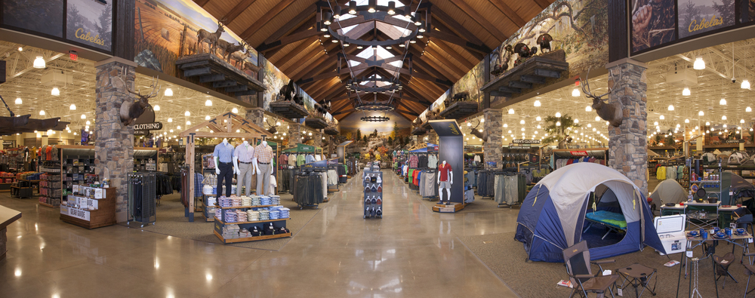
Aahhhh….The Gear…
Waders, chest or hip
Coats, Hats, Sweaters, UnderArmor, Gloves
GUNS & AMMO!

Slide 9
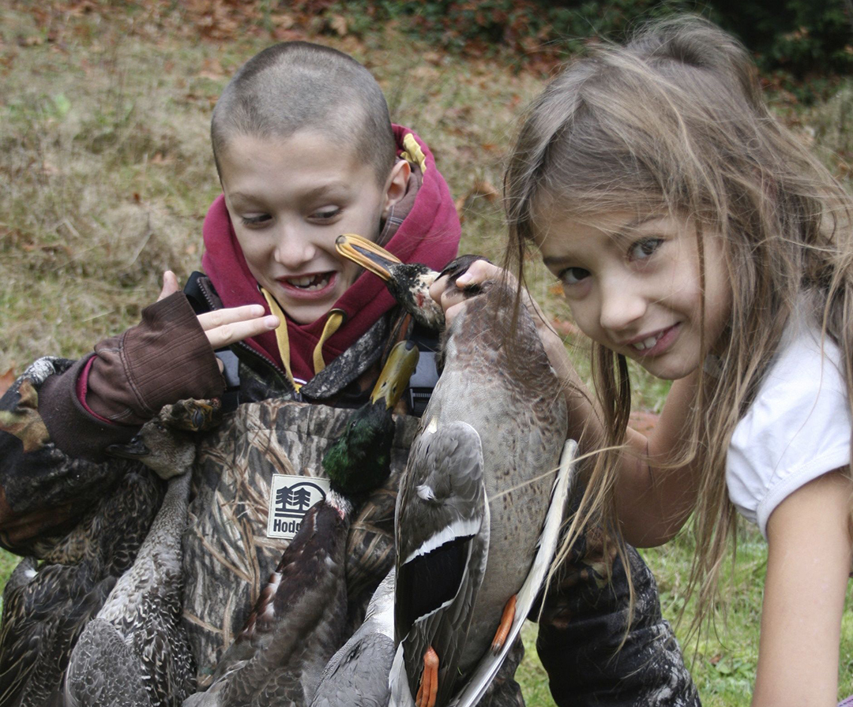
Getting the Kids Involved!

Slide 10
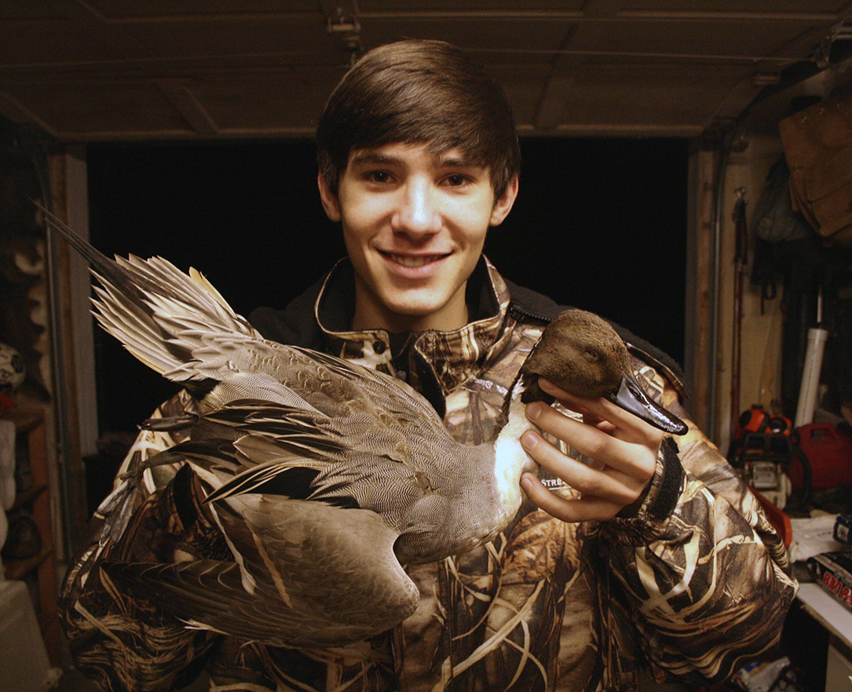

Slide 11
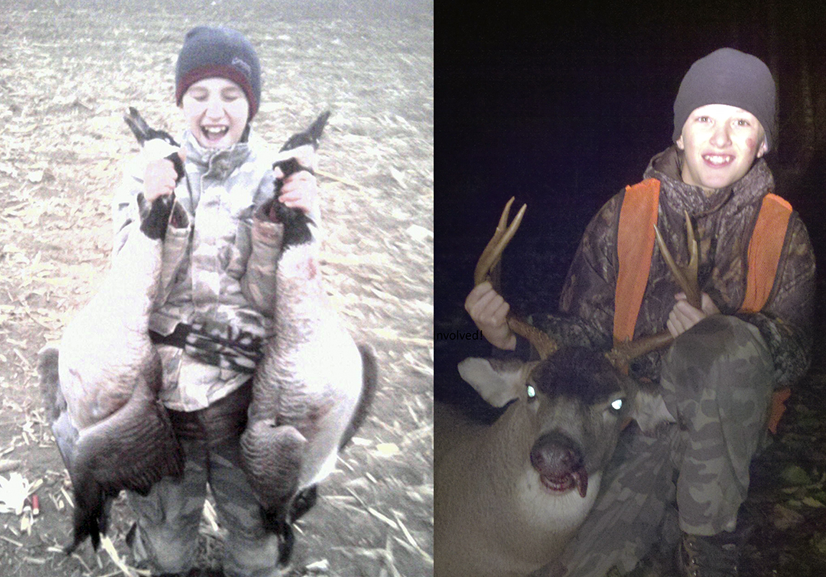

Slide 12
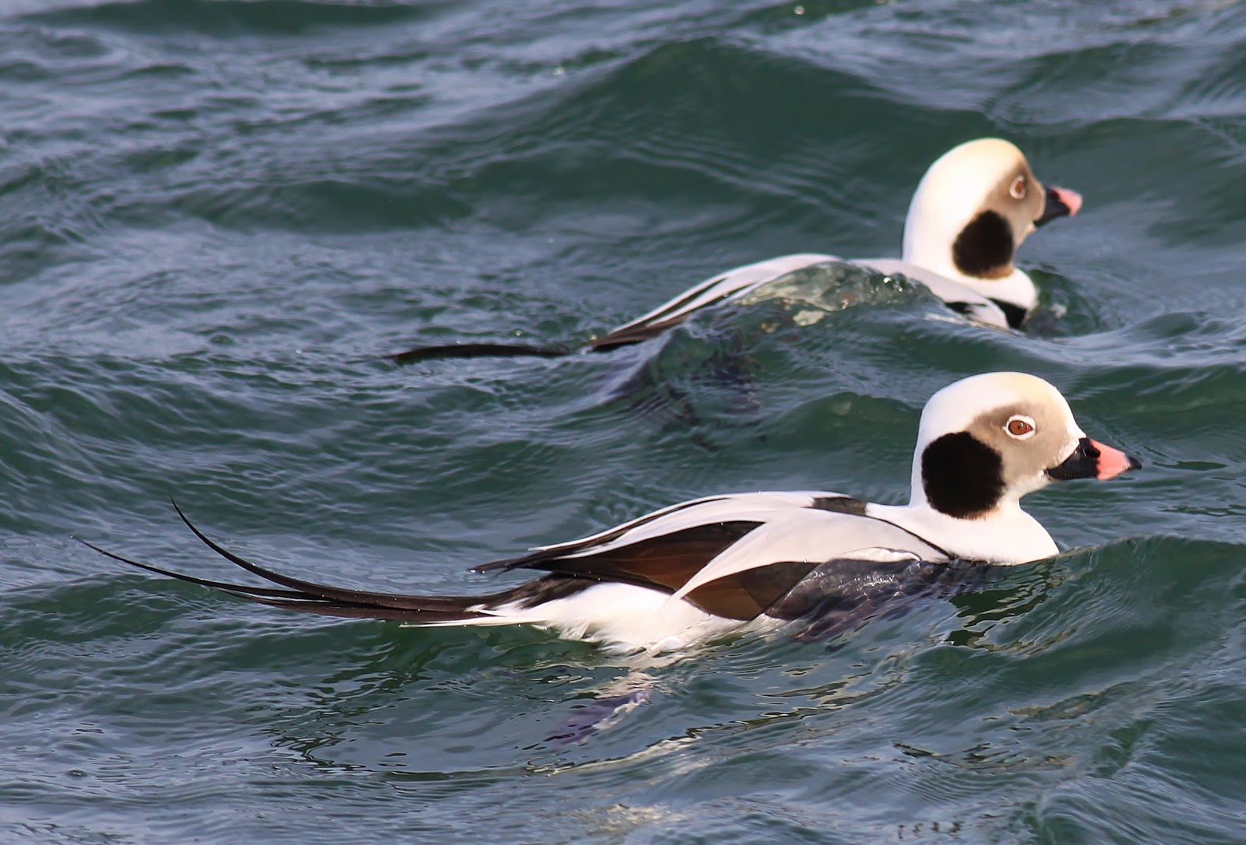
Some Great Video Links
Small Water Decoying-The Grind:
https://www.youtube.com/watch?v=tMFCaOMzHRY
Duck Commander intro:
https://www.youtube.com/watch?v=n0Qk2bNOGT4
For a few Ducks More: (2min)
https://www.youtube.com/watch?v=UKZs8vV8La0
Oregon Cacklers Team Deadfowl:
https://www.youtube.com/watch?v=tOkQJmCPDAQ
Awesome goose shooting – WARNING Language - Turn OFF THE SOUND!
https://www.youtube.com/watch?v=3jWvEK9hVII
One of my first hunting videos…
Ty and Doug Woodall Shoot ducks in Eastern WA:
https://www.youtube.com/watch?v=rNaxAdYtUUU

